Slide 1


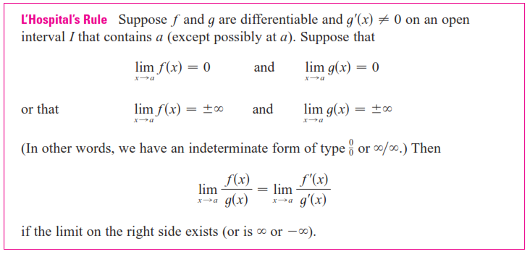
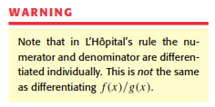

Slide 2
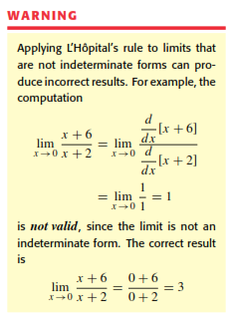

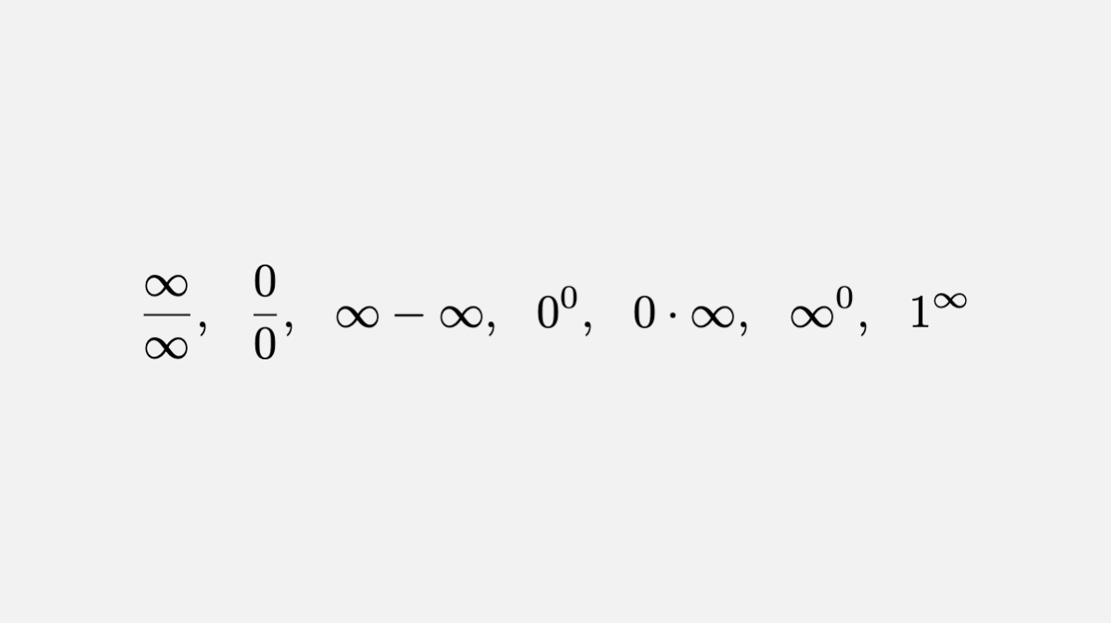
Indeterminate Forms:

Slide 3
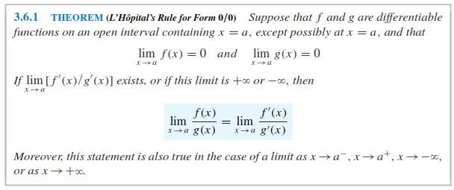
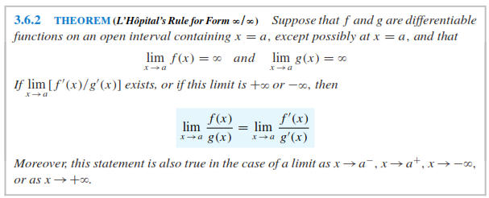
Indeterminate Forms:

Slide 4



Slide 5
Indeterminate Forms:

Slide 6
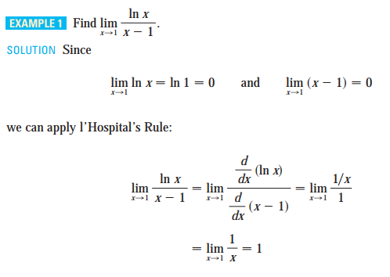
Type : 0/0
Indeterminate Forms:

Slide 7
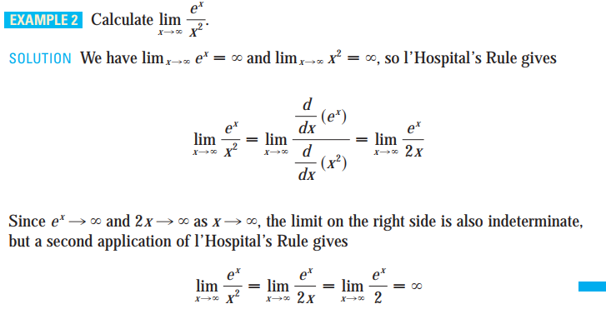

Type : $∞$/ $∞$
Indeterminate Forms:

Slide 8


Type : $0.∞$
Indeterminate Forms:

Slide 9

Type : $0.∞$
Indeterminate Forms:

Slide 10
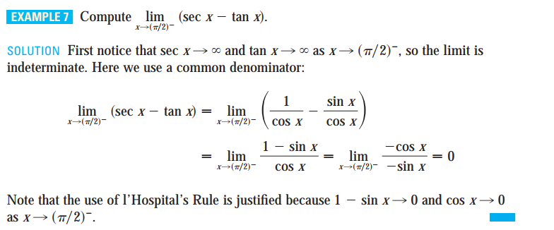

Type :$∞−∞$
Indeterminate Forms:

Slide 11
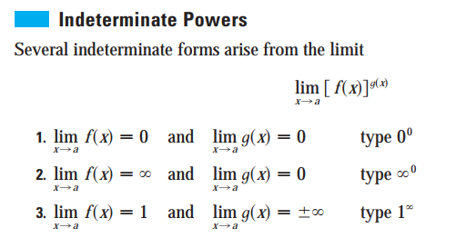


Slide 12


Slide 13
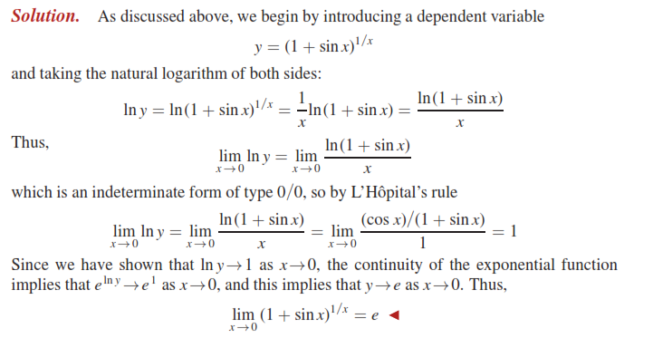

Slide 14
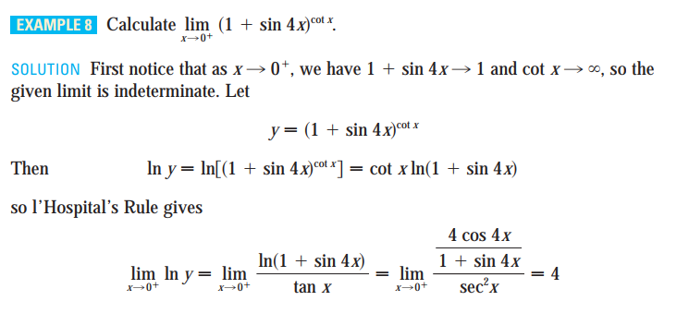

Type :$Indeterminate Power$
Indeterminate Forms:

Slide 15

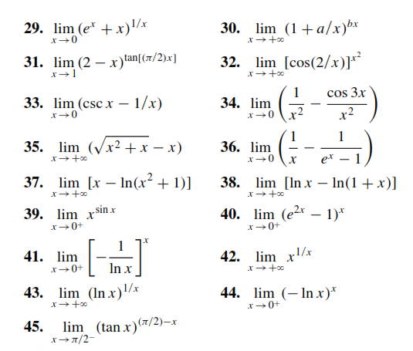
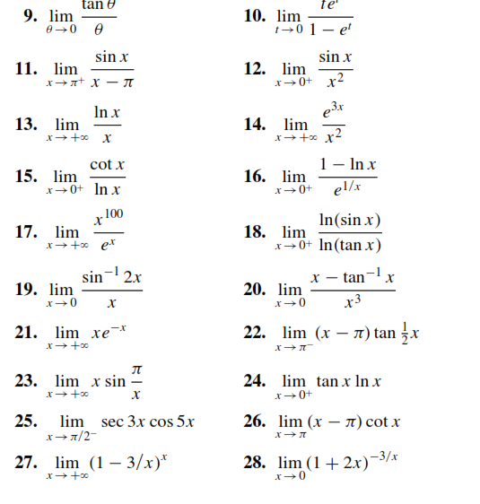

Slide 17
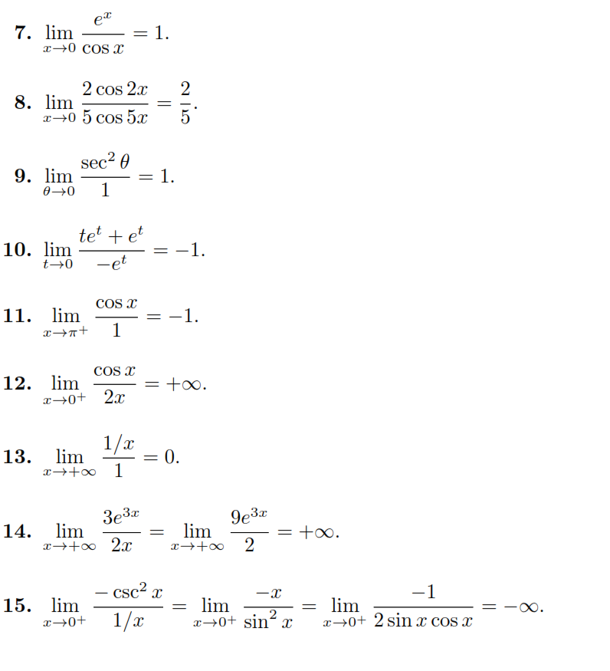
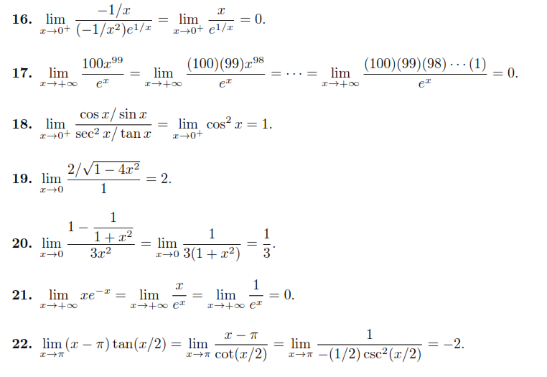

Slide 18
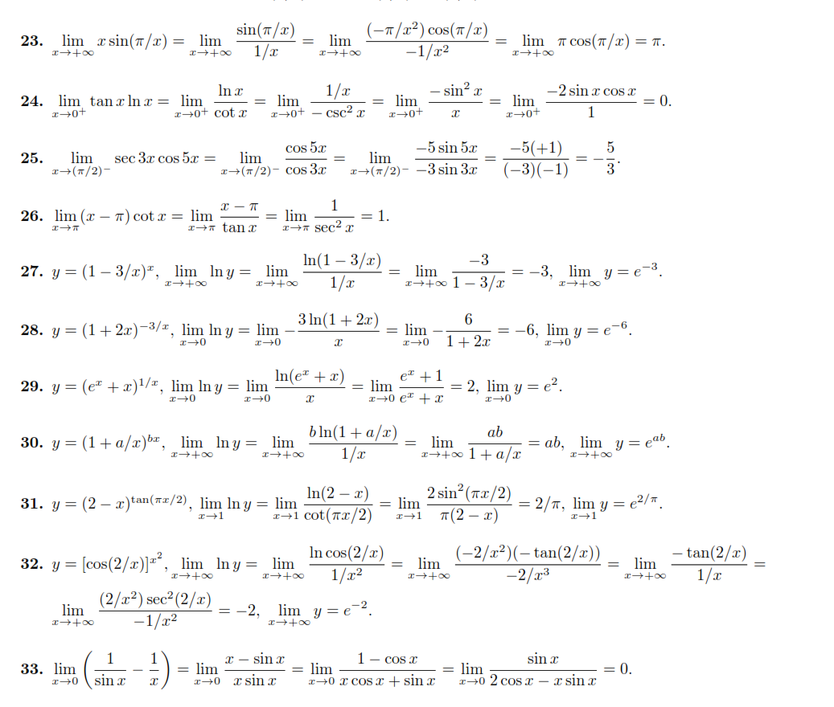

Slide 19
